Slide 1






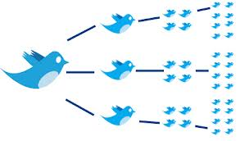


TEXT ANALYTICS Sentiment Analysis Part I MSBA Fall 2019 November 04,05
Dr. Anitesh Barua
David Bruton Jr. Centennial Chair Professor of Business
Distinguished Fellow, INFORMS Information Systems Society
Stevens Piper Foundation Professor
University of Texas Distinguished Teaching Professor
McCombs School of Business, University of Texas at Austin
Email: aniteshb@gmail.com

Slide 2
Can Social Mentions Predict Box Office Hits?
Predictive power of social mentions for movies: http://www.youtube.com/watch?v=uHmn2qsgBsU
Top 10 Box Office Hits of 2012 (Hollywood)
Average # social mentions: 244,000
Change in mentions volume from pre -> post release: +70%
Opening day average volume: 23,000 in 24 hours
Average negative sentiment: 9% (of total mentions)
Pre- to post-release: Negatives stayed constant at ~ 9%
Top 10 Box Office Flops of 2012
Average # mentions: 45,000
Change in volume from pre -> post release: +17%
Opening day average volume: 4,000 in 24 hours
Average negative sentiment: 23%
Pre- to post-release: Negatives increased from 23% to 27%
Source: http://socialmediatoday.com/brendan-williams/1519036/two-thumbs-using-social-media-trends-anticipate-box-office-success

Slide 3


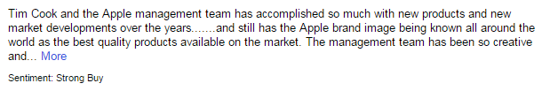
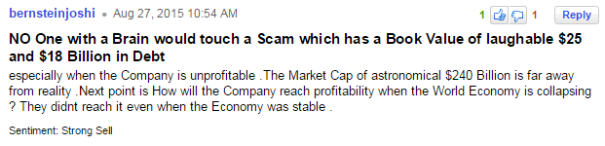
Incorporating Sentiments & Mentions in the Returns Model
Do message sentiments improve prediction?
Training data for stock sentiments

Slide 4
Predicting Stock Returns (the Trillion $ Question): Do Sentiments Matter?
Capital Asset Pricing Model (CAPM)
Fama-French factors
Return on an asset
r = R_{f} + β.(K_{m} – R_{f}) + b_{s}.SMB + b_{v}.HML + α
R_{f}: risk free rate, K_{m}: Return of market portfolio
SMB: Small (market cap) minus big
HML: High (book-to-mkt) minus low
Addition of momentum (Up minus Down) factor

Slide 5
Unsupervised Sentiment Analysis
Many approaches, but all use reference positive & negative words
Lexicons with either binary tags or valence (intensity of sentiment)
Can incorporate other features – e.g., bigrams, sentiment shifters, etc.
Parts-of-speech (POS) tagging
POS: Noun, verb, adjective, adverb, pronoun, preposition, conjunction & interjection
Extract adjectives
Isolated adjectives may not indicate true opinion orientation
Extract two consecutive words if their POS conform to a pattern
Studied heavily in linguistics

Slide 6
Extract Two-Word Phrases Using Parts-of-Speech Tagging
Rule | First word | Second Word | Third word (not extracted)
1. | JJ (Adjective) | NN or NNS | Anything
2. | RB (Adverb), RBR or RBS | JJ | Not NN or NNS
3. | JJ | JJ | Not NN or NNS
4. | NN (Noun) or NNS | JJ | Not NN or NNS
5. | RB, RBR or RBS | VB (verb), VBD, VBN or VBG | Anything
E.g., “This business runs like a virtual monopoly.”
Tagging tool: http://cogcomp.cs.illinois.edu/demo/pos/?id=4

Slide 7
Mining the Sentiment
Associate extracted phrases with
positive reference words like “excellent”, “great”, etc.
negative reference words like “poor”, “terrible”, etc.
See which association is dominant

Slide 8
Unsupervised Learning Using POS
Point-wise mutual information (PMI) of two phrases (or words) = amount of information we get about the presence of one phrase given the presence of the other.
p(phrase 1 and phrase 2) / [p(phrase 1) * p(phrase 2)] shows how statistically dependent the phrases are
where p is the probability
E.g., p(“virtual monopoly” and “awesome”) / [p(“virtual monopoly”) * p(“awesome”)]
Taking log of the above gives us the “quantity” of information we get about one phrase in the presence of the other
PMI = log₂ [p(phrase 1 and phrase 2) / p(phrase 1) * p(phrase 2)]

Slide 9
Calculating Semantic Orientation
Opinion orientation (a.k.a. semantic orientation) = PMI(“virtual monopoly”, “awesome) – PMI(“virtual monopoly”, “terrible”) = log₂ of the ratio below:
# cases of “virtual monopoly” AND “awesome” * # cases of “terrible”
-------------------------------------------------------------------------------------
#cases of “virtual monopoly” AND “awesome” * # cases of “awesome”

Slide 10
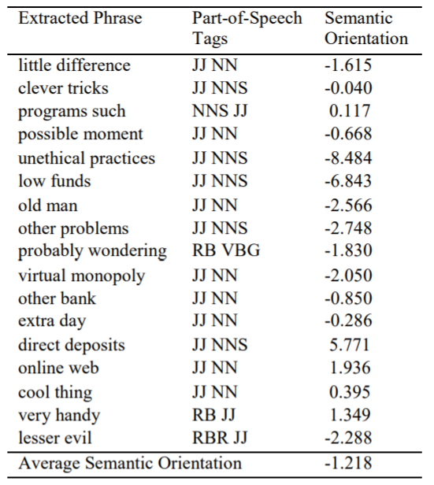
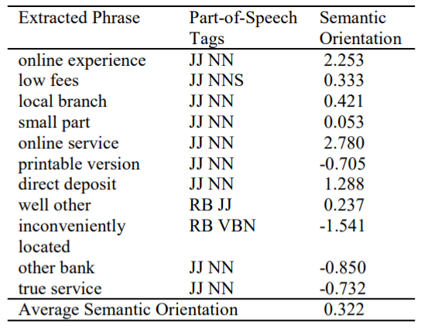
Applying POS Bigrams for Opinion Mining
Processing of a review where author
summarized as “recommended”
Processing of a review where author
summarized as “not recommended”

Slide 11
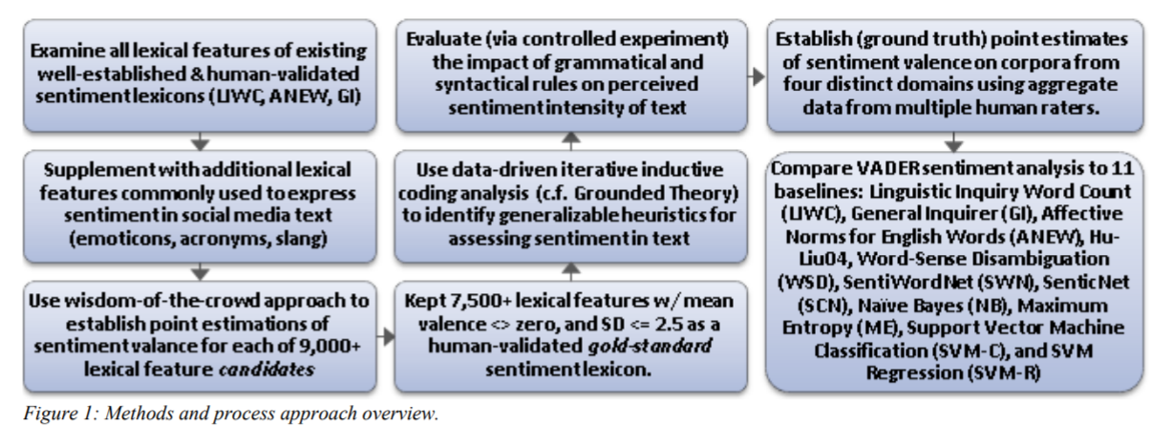
Valence Aware Dictionary for sEntiment Reasoning (VADER)
A popular tool for unsupervised sentiment analysis
Available in Python
Source: Hutto & Gilbert 2014

Slide 12
Adds Human Heuristics for Expressing Sentiments
Punctuation, e.g., ! increases the sentiment intensity
Capitalization, e.g., ALL-CAPS
Degree modifiers, e.g., “The service here is extremely good”
Sentiment shifters, e.g., “The food here is great, but the service is horrible”
Trigram preceding a sentiment-laden lexical feature: Catch nearly 90% of cases where negation flips the polarity of the text.
E.g., “The food here isn’t really all that great”.
Source: Hutto & Gilbert 2014

Slide 13
Multiple Products, Multiple Attributes
“The lobby of the Coastal Delight was cool, but the room was nothing to write home about; the food was good, but the location was too far away from public transportation. In hindsight, although the Tuscany Grand was very pricey, its awesome location and high-end ambience would have been great.”
Assumption: People express emotions in close proximity to the mentions of entities and/or attributes.
Parse and extract phrases that are “relevant”
E.g., Dell & warranty, hotel & lobby, etc.
Then pass through standard sentiment analyzers

